Slide 1
The Employee Assistance Programme (EAP) is completely free to access for all employees and the 24/7 helpline counselling support and access to 6 sessions of structured telephone counselling also extend to cover your partner/spouse and dependants (aged 16-24, living at the same address and in full time education).
The Employee Assistance Programme (EAP) is available as a mobile application for ease. Please search ‘My healthy Advantage’ on the app store or google play & use the mobile app access code MHA193522.
Primary Care
Wellbeing Support
Notes:
Liverpool city council have a hub of support to do with financial support - Financial support - Liverpool City Council
We’ve listed all the CAB around the north west –
Liverpool CVS have a range of information available from energy bills support, warm hubs right through to community food spaces Map - Feeding Liverpool
The live well directory host an array of information from health, wealth right through to education

Slide 2
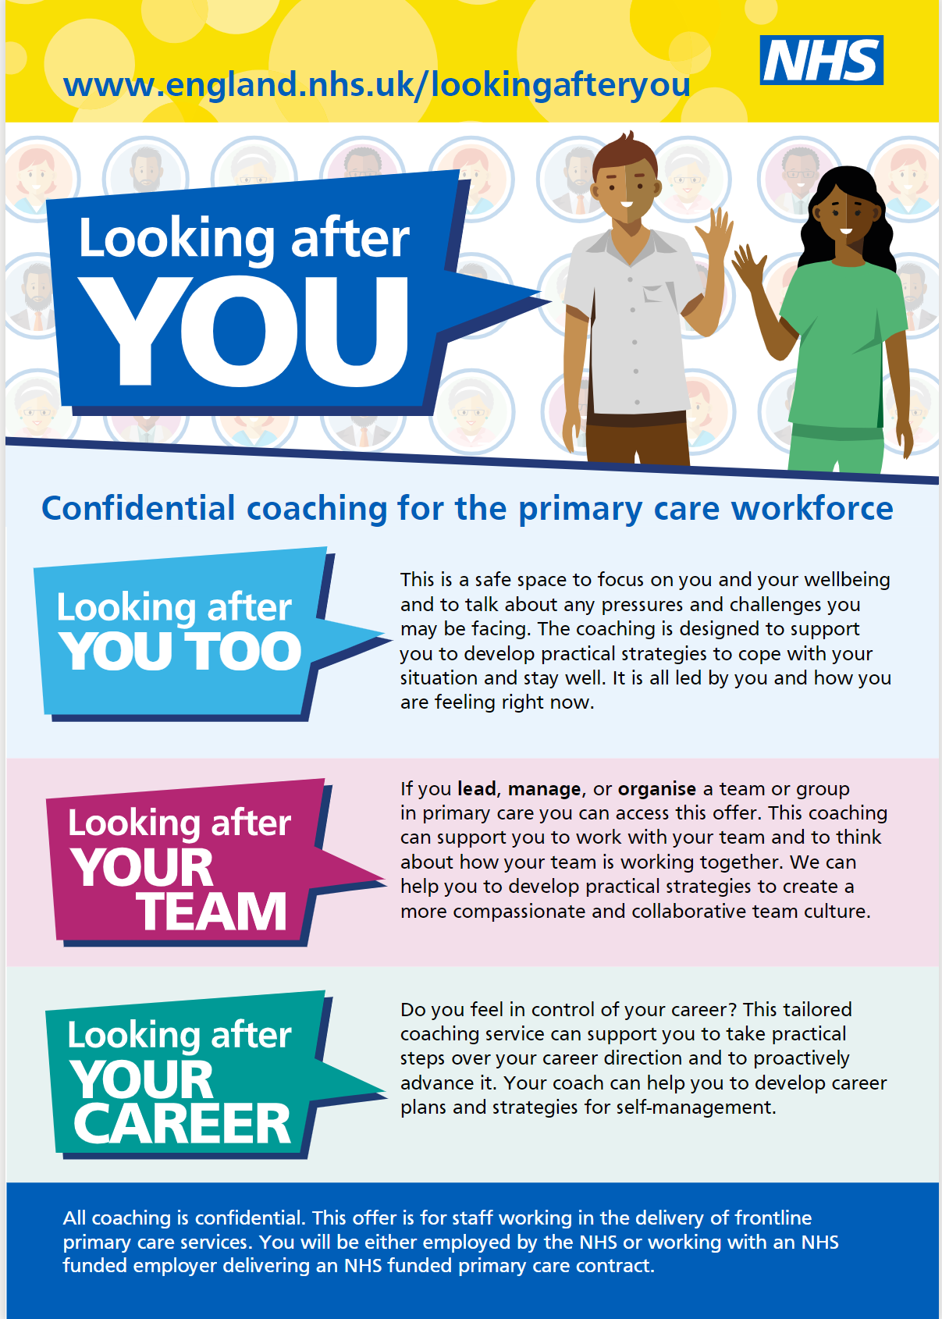
Looking After You is an initiative from NHS England recognising frontline primary care colleagues, both clinical and non-clinical, are continuing to work hard caring for their patients.
Individual coaching is available with a skilled and experienced coach who will work with you to discuss any area of your wellbeing that you would like to address. They will listen, ask questions and support you to develop practical strategies to cope with your situation and stay well.
It might be that by having a one-off conversation you will have all the strategies you need, or you might find a few sessions helpful. It is all led by you.
Primary Care
Wellbeing Support
Notes:
Liverpool city council have a hub of support to do with financial support - Financial support - Liverpool City Council
We’ve listed all the CAB around the north west –
Liverpool CVS have a range of information available from energy bills support, warm hubs right through to community food spaces Map - Feeding Liverpool
The live well directory host an array of information from health, wealth right through to education

Slide 3
NHS Employers - https://www.nhsemployers.org/
The employers’ organisation for the NHS in England; supporting workforce leaders and representing employers and systems to develop a sustainable workforce and be the best employers they can be.
NHS Future - North West Staff Experience and Engagement Community of Practice - FutureNHS Collaboration Platform
Staff Experience and Engagement team sharing national and regional updates on Health and Wellbeing, Engagement and Retention. A place for you to connect with the North West region; to share ideas, good practice, to raise and answer questions, to support new initiatives and be part of the wider community
NHS health and wellbeing framework - https://www.england.nhs.uk/publication/nhs-health-and-wellbeing-framework/
Including a diagnostic tool and implementation plan, this is a high-level culture change toolkit aimed at health and wellbeing guardians, managers and leaders and anyone with an interest.
People Plan - https://www.england.nhs.uk/ournhspeople/
NHS England’s workforce strategy and actions to establish the pillars of ‘looking after our people’, ‘belonging in the NHS’, ‘new ways of working and delivering care’ and ‘growing for the future’.
Primary Care Bulletin - https://www.england.nhs.uk/email-bulletins/primary-care-bulletin/
A weekly bulletin from NHS England covering all guidance and information published for general practice, pharmacy, dental and optical.
Primary Care
Wellbeing Support
Notes:
Liverpool city council have a hub of support to do with financial support - Financial support - Liverpool City Council
We’ve listed all the CAB around the north west –
Liverpool CVS have a range of information available from energy bills support, warm hubs right through to community food spaces Map - Feeding Liverpool
The live well directory host an array of information from health, wealth right through to education

